Slide 1
COMP 2100
Week 10 - Monday

Slide 2
Last time
What did we talk about last time?
Cycle detection
Topological sort
Connectivity
Minimum spanning tree

Slide 3
Questions?

Slide 4
Project 3

Slide 5
Assignment 5

Slide 6
Shortest Paths

Slide 7
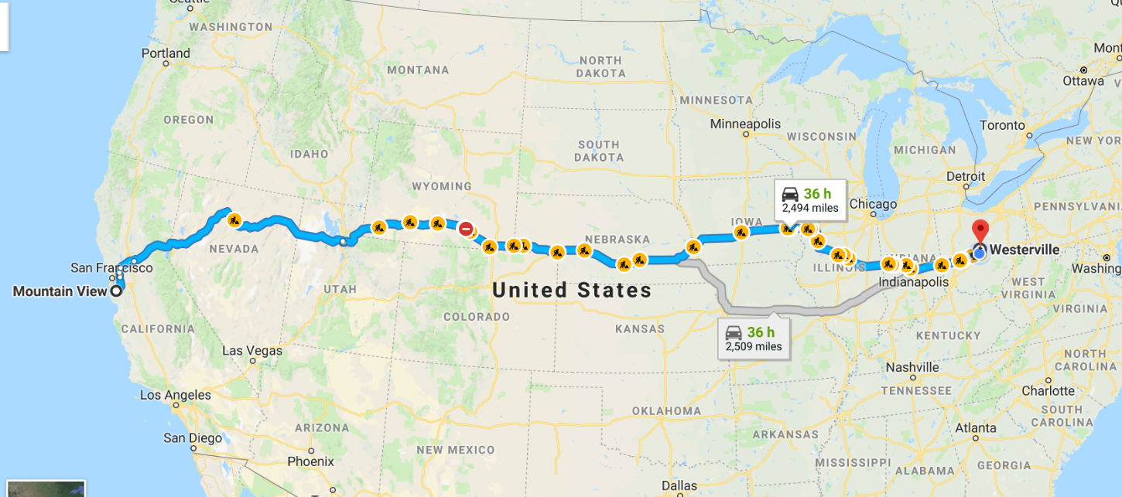
Google Maps
How does Google Maps find the shortest route from Silicon Valley to Westerville?
Graph theory, of course!
It stores a very large graph where locations are nodes and streets (well, parts of streets) are edges

Slide 8
Shortest paths
We use a weighted graph
Weight can represent time, distance, cost: anything, really
The shortest path (lowest total weight) is not always obvious
B
6
5
2
D
8
3
4
C
A
16
E

Slide 9
What’s the shortest path?
Take a moment and try to find the shortest path from A to E.
The shortest path has cost 14
B
6
B
5
D
2
D
8
3
4
C
C
A
A
E
16
E

Slide 10
How can we always find the shortest path?
On a graph of that size, it isn't hard to find the shortest path
A Google Maps graph has millions and millions of nodes
How can we come up with an algorithm that will always find the shortest path from one node to another?

Slide 11
Dijkstra’s Algorithm
In 1959, Edsger Dijkstra published an algorithm to find shortest paths
Notation | Meaning
s | Starting node
d(v) | The best distance from s to v found so far
d(u, v) | The direct distance between nodes u and v
S | A set which contains the nodes for which we know the shortest path from s
V | A set which contains the nodes for which we do not yet know the shortest path from s
pred(u) | Predecessor of u in the shortest path from s

Slide 12
Dijkstra’s Algorithm
Start with two sets, S and V:
S is empty
V has all the nodes in it
Set the distance to all nodes in V to ∞
Set the distance to the starting node s to 0
Find the node u in V that is closest to s
For every neighbor v of u in V
If d(v) > d(u) + d(u,v)
Set d(v) = d(u) + d(u,v)
Set pred(v) = u
Move u from V to S
If V is not empty, go back to Step 4

Slide 13
Example for Dijkstra
Node | d(u) | pred(u)
A | 0 | -
B | 5 | A
C | 7 | B
D | 10 | C
E | 16 | A
Node | d(u) | pred(u)
A | 0 | -
B | 5 | A
C | 7 | B
D | 10 | C
E | 14 | D
Node | d(u) | pred(u)
A | 0 | -
B | ∞
C | ∞
D | ∞
E | ∞
Node | d(u) | pred(u)
A | 0 | -
B | 5 | A
C | 7 | B
D | 11 | B
E | 16 | A
Node | d(u) | pred(u)
A | 0 | -
B | 5 | A
C | 8 | A
D | ∞
E | 16 | A
Sets
S | V
A | B, C, D, E
Sets
S | V
A, B | C, D, E
Sets
S | V
A, B, C | D, E
Sets
S | V
A, B, C, D | E
Sets
S | V
A, B, C, D, E
Sets
S | V
 | A, B, C, D, E
Finding the shortest distance from A to all other nodes
B
6
5
2
D
8
3
4
C
A
A
16
E

Slide 14
Features of Dijkstra
Always gets the next closest node, so we know there isn’t a better way to get there
Finds the shortest path from a starting node to all other nodes
Works even for directed graphs
Provided that they don't have negative edge weights

Slide 15
Dijkstra's running time
The normal running time for Dijkstra's is O(|V|²)
At worst, we may have to update each node in V for each node v that we find the shortest path to
A special data structure called a min-priority queue can implement the process of updating priorities faster
Total running time of O(|E| + |V| log |V|)
Technically faster for sparse graphs
Algorithm wizards Fredman and Tarjan created an implementation called a Fibonacci Heap
Actually slow in practice

Slide 16
Dijkstra's practice
7
8
B
A
I
C
D
4
12
2
3
3
1
5
5
5
9
E
1
H
6
4
F
2
G
11
10
5
4
9
J
1
K
L

Slide 17
Matching

Slide 18
Bipartite graphs
A bipartite graph is one whose nodes can be divided into two disjoint sets X and Y
There can be edges between set X and set Y
There are no edges inside set X or set Y
A graph is bipartite if and only if it contains no odd cycles

Slide 19
Bipartite graph
X
A
B
C
D
E
F
Y
A
B
C
D
E
F

Slide 20
Maximum matching
A perfect matching is when every node in set X and every node in set Y is matched
It is not always possible to have a perfect matching
We can still try to find a maximum matching in which as many nodes are matched up as possible

Slide 21
Matching algorithm
Come up with a legal, maximal matching
Take an augmenting path that starts at an unmatched node in X and ends at an unmatched node in Y, alternating the kind of edges it cross (first unmatched, then matched, then unmatched, etc.)
If there is such a path, switch all the edges along the path from being in the matching to being out and vice versa
If there's another augmenting path, go back to Step 2

Slide 22
Match the graph
Anna
Becky
Caitlin
Daisy
Erin
Fiona
X
A
B
C
D
E
F
Y
A
B
C
D
E
F
Adam
Ben
Carlos
Dan
Evan
Fred

Slide 23
Upcoming

Slide 24
Next time…
Finish matching
Stable marriage
Euler paths and tours

Slide 25
Reminders
Keep working on Project 3
Start Assignment 5
Read sections 6.2 and 6.4

